Slide 1
Isolation level in transaction
SHIVA Kumar
Section:- cse (c )
Roll No : 227r1a05j3
Database management system

Slide 2
Introduction to Isolation level
Isolation determines how the transaction integrity is visible to other user and system
It means that a transaction should take place in a system in such a way that ,it is the only transaction that is accessing the resources in a database system
Isolation levels defines the degree to which a transaction must be isolated from the data modification made by any other transaction in the database system

Slide 3
A Transaction isolation level are defined by the following Phenomena :-
Dirty reads
Non-repeatable read
Phantom read

Slide 4
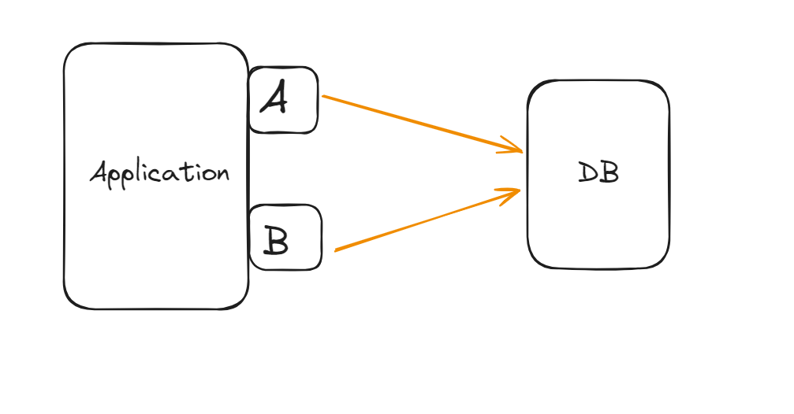

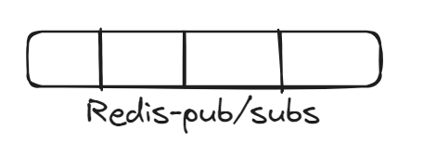
Why we need Transaction Isolation Level

Slide 5
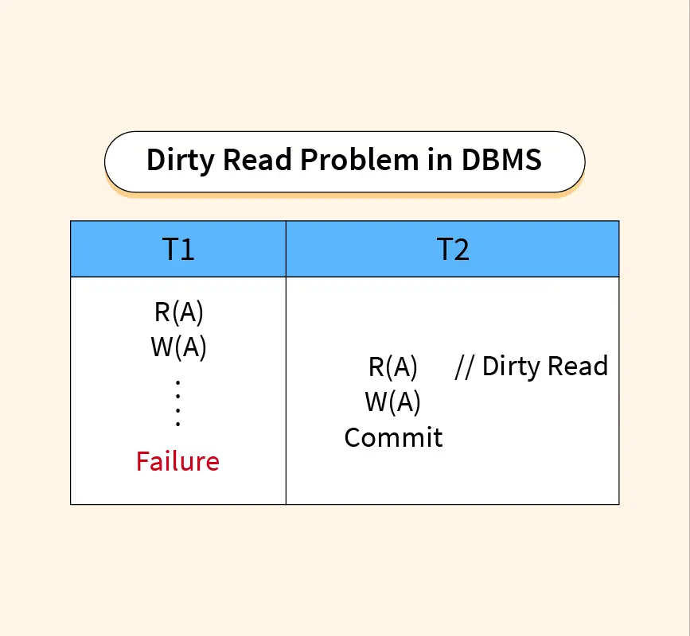
1.Dirty Read
A Dirty read is a situation when a transaction reads a data that has not yet been committed.

Slide 6
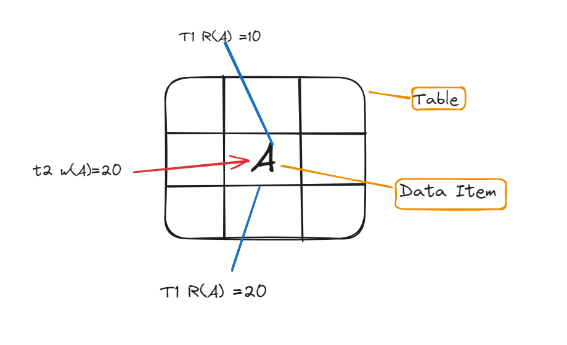
2.Non-Repeatable Read
Non-Repeatable read occur when a transaction reads same row twice and get a different value each time.

Slide 7
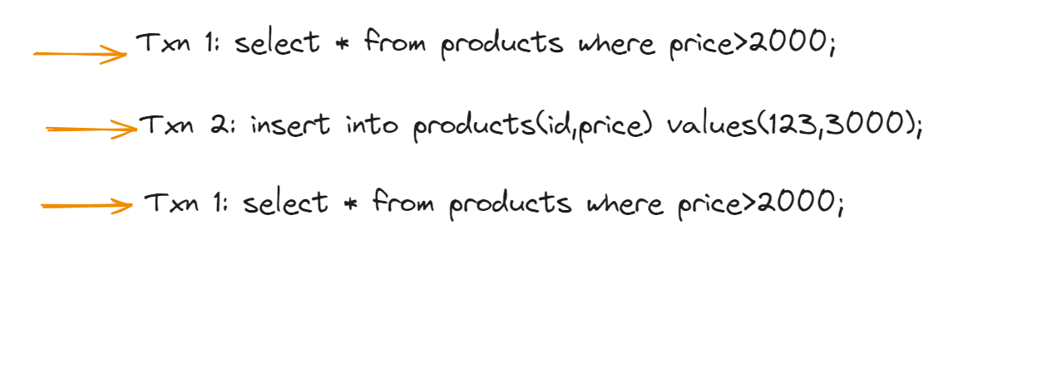
3.Phantom Reads
Phantom reads occur when two same queries are executed but the rows retrieved by the two are different

Slide 8
Based on these phenomena, The SQL standard defines four isolation levels:
1 .Read Uncommitted – Read Uncommitted is the lowest isolation level. In this level, one transaction may read not yet committed changes made by other transactions, thereby allowing dirty reads. At this level, transactions are not isolated from each other.
2.Read Committed – This isolation level guarantees that any data read is committed at the moment it is read. Thus it does not allow dirty read. The transaction holds a read or write lock on the current row, and thus prevents other transactions from reading, updating, or deleting it.

Slide 9
Based on these phenomena, The SQL standard defines four isolation levels:
3 . Repeatable Read – This is the most restrictive isolation level. The transaction holds read locks on all rows it references and writes locks on referenced rows for update and delete actions. Since other transactions cannot read, update or delete these rows, consequently it avoids non-repeatable read.
4 . Serializable – This is the highest isolation level. A serializable execution is guaranteed to be serializable. Serializable execution is defined to be an execution of operations in which concurrently executing transactions appears to be serially executing.

Slide 10
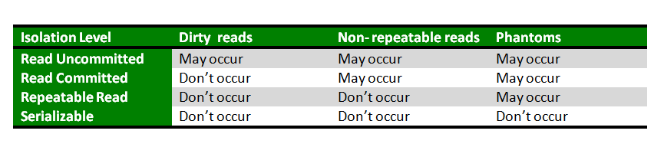
The relationship between isolation levels

Slide 11


